Slide 1
Papers Presentation
Quan Nguyen

Slide 2
Improving Dysarthric Speech Intelligibility
Using Cycle-consistent Adversarial Training

Slide 3
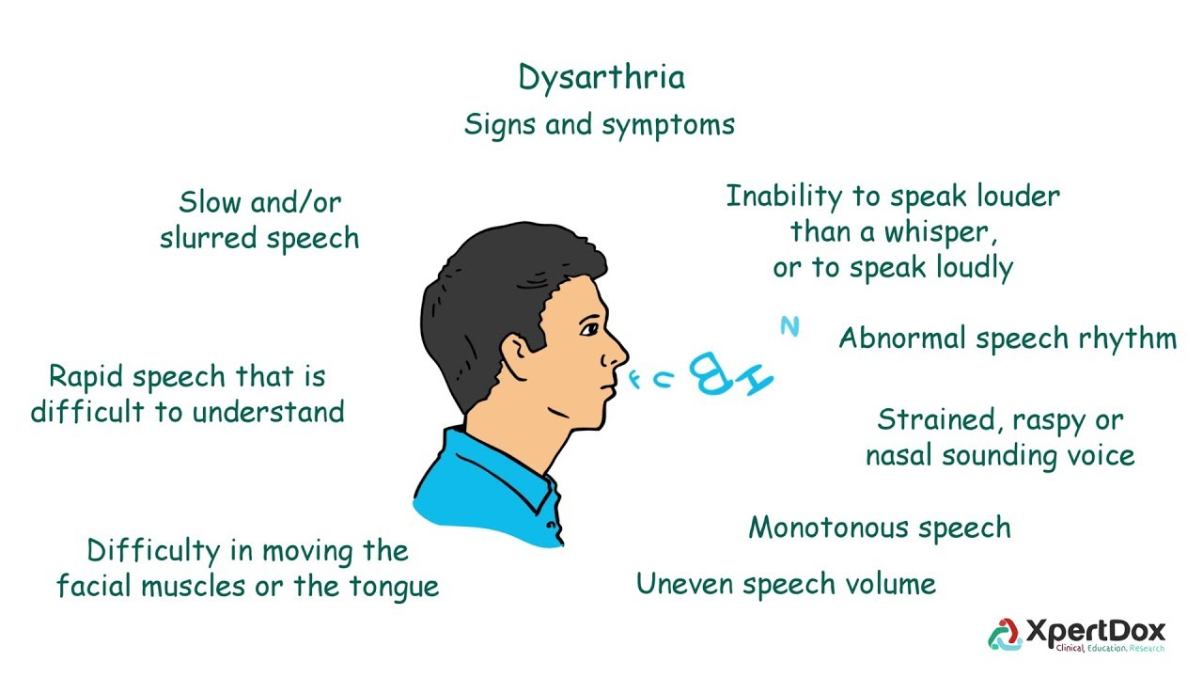
Dysarthric speech
“Dysarthria and dysphagia occur frequently in Parkinson’s disease (PD). Reduced speech intelligibility is a significant functional limitation of dysarthria, and in the case of PD is likely related articulatory and phonatory impairment.”^{[1]}
[1]: Tjaden K. Speech and Swallowing in Parkinson's Disease. Top Geriatr Rehabil. 2008;24(2):115-126. doi: 10.1097/01.TGR.0000318899.87690.44. PMID: 19946386; PMCID: PMC2784698.

Slide 4
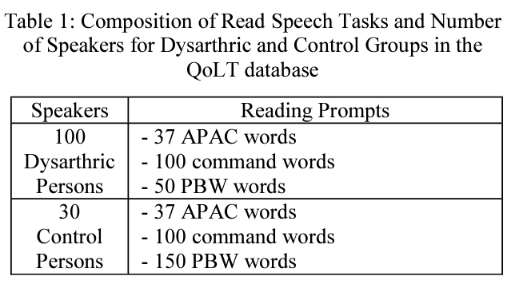
Speech material
Speech database of 100 dysarthric persons of low, moderate and severe degrees of disability has been recorded in a related project called QoLT (Quality of Life Technology)
The command words were designed to represent the Korean alphabet letters for the purpose of speech recognition when controlling electronic appliances, such as a cell phone, PC, TV, and a radio
Dysarthric speakers had the age range from 30 to 40, and the ratio of male and female was 2:1
Healthy control speakers were also recorded with the same age and gender distributions

Slide 5
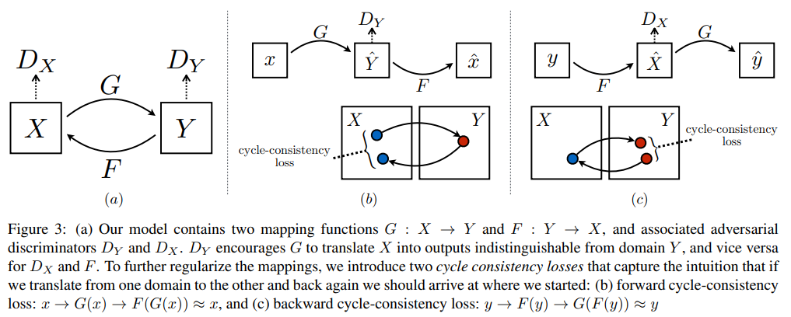
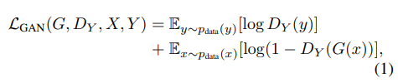

Method (GAN)
Adversarial Loss: G tries to generate spectrograms G(x) that look similar to spectrograms from domain Y , while D_{Y} aims to distinguish between translated samples G(x) and real samples y. G aims to minimize this objective against an adversary D that tries to maximize it (minG maxD_{Y} L_{GAN}(G, D_{Y}, X, Y))
Cycle-consistency loss was further introduced to reduce the space of possible mapping functions

Slide 6
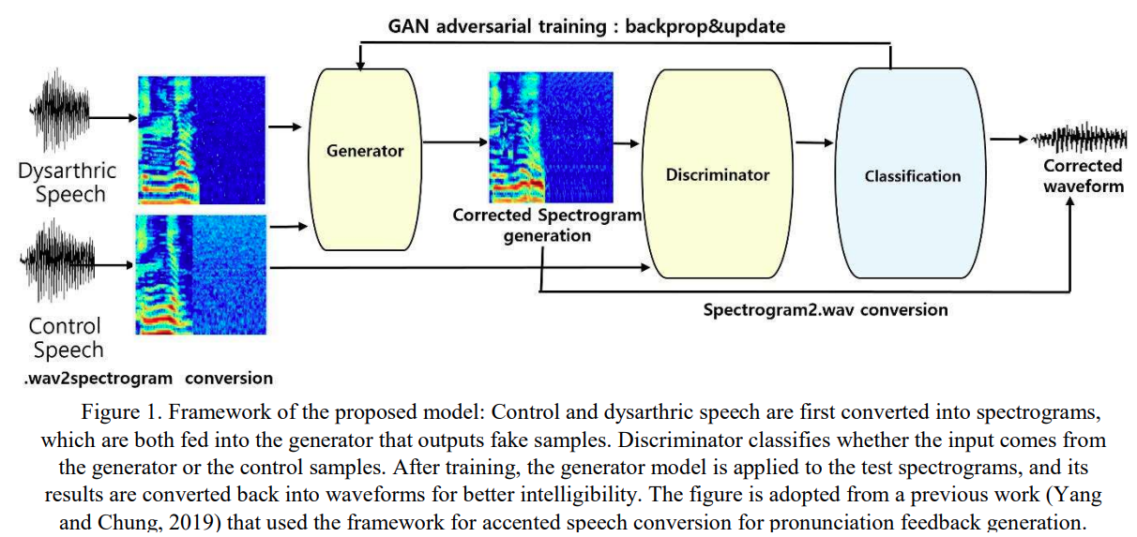
Method (cycleGAN for improving dysarthric speech)
Reasons choosing cycleGAN:
To avoid having many possible outputs, cycle-consistency loss desirable.
Despite the differences in the two speech styles, the speech of the same utterance shares an underlying structure. Since cycle-consistency loss preserves the translation cycle, it is our hypothesis that it will have the effect of preserving the global structure of the input spectrograms. Therefore, it is the hypothesis in this work that CycleGAN may have the effect of prohibiting from generating infinitely many possible acceptable outputs while preserving the global structure of the input speech

Slide 7
Method (speech and spectrogram conversions)
Convert audio signal to a wideband spectrogram using Short-Time Fourier Transform (STFT) with windows of 512 frames and 33% overlap.
It is converted to wideband spectrograms ranging from 100-200Hz, which allows for high quality output in the time resolution.
It is then converted to dB amplitude scale, and padded with white noise to generate 128x128 pixels images.
White noise padding is done in order to adjust the variability in speech length to a fixed size.
Reconstruct the audio signal: use the Griffin and Lim algorithm that use the magnitude of the STFT.

Slide 8
Method (cycleGAN implementations)
The cycle-consistent adversarial training follows the same network architecture as original cycleGAN,
For the discriminator training, Markovian PatchGAN is used for classifying if each N x N patch in an image is real or fake.
Dysarthric and control spectrogram images are fed into the CycleGAN network.
Trained on 18,700 spectrogram images in the dysarthric domain and on 8,610 spectrogram images in the control group
Trained for 1,000 iterations

Slide 9
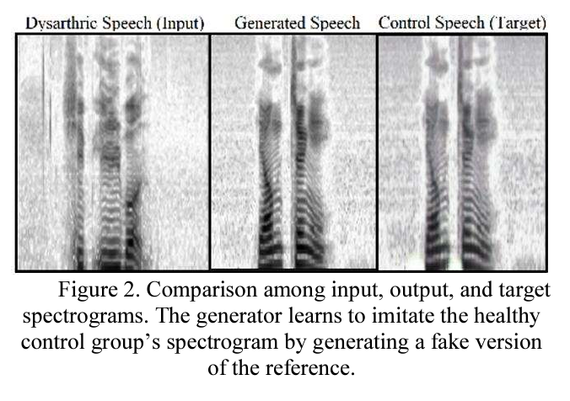
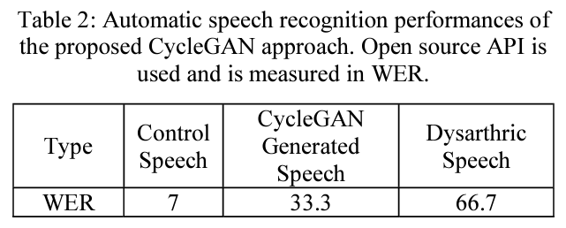
Results and Evaluation
Table 2 displays the ASR (using Google Cloud STT ) performance in terms of WER obtained from 100 test samples of generated speech signals and 200 samples of the original signals from the QoLT database.
The test samples are generated sounds and contains a certain amount of noise and artifacts, which may lower recognition accuracies. The latter includes clean speeches from control and dysarthric groups
For clean speech of the control group WER is 7%.
Comparing the recognition accuracies of the original dysarthric with the generated speech the system performance is improved using the proposed method. The WER has been lowered by 33.4%, even with some artifacts introduced in the course of lossy conversions.

Slide 11
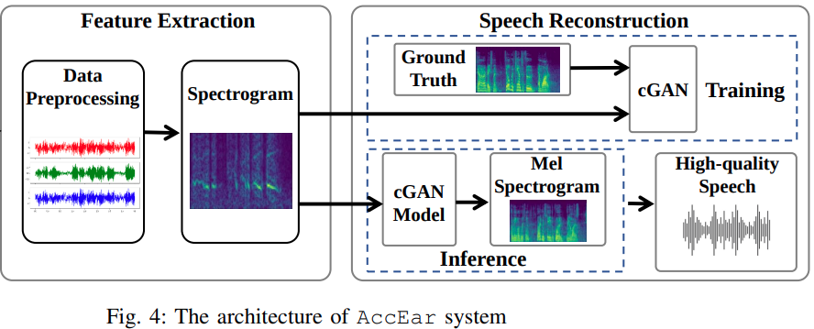
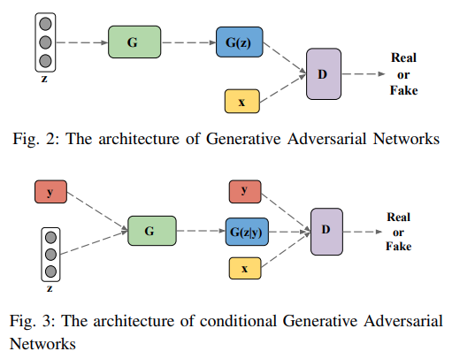
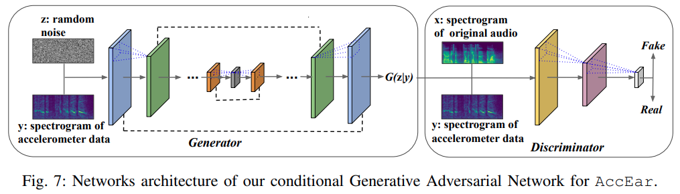

Slide 12
A Fully Convolutional Neural Network for Complex Spectrogram Processing in Speech Enhancement.

Slide 13
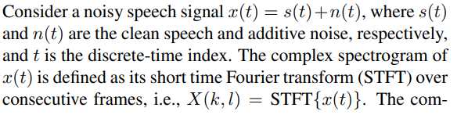
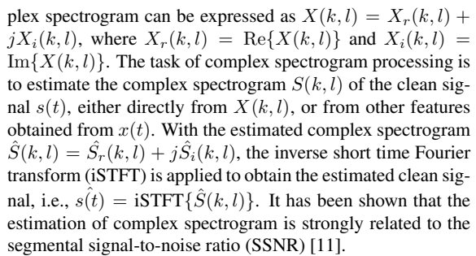
Complex Spectrogram
Twofolds of using complex spectrogram:
Estimating the magnitude and phase at the same time, while avoiding the difficulty of phase estimation with neural networks
Due to the similarity between real and imaginary spectrograms, it is possible to use a single neural network to estimate them jointly
*: Explaining convolutional neural networks using softmax gradient layer-wise relevance propagation

Slide 14
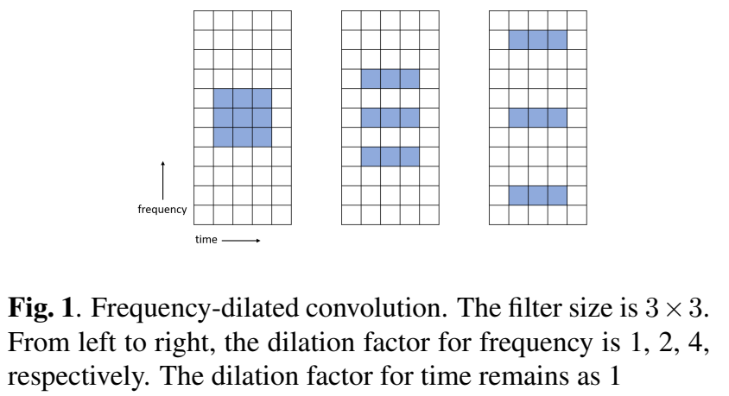
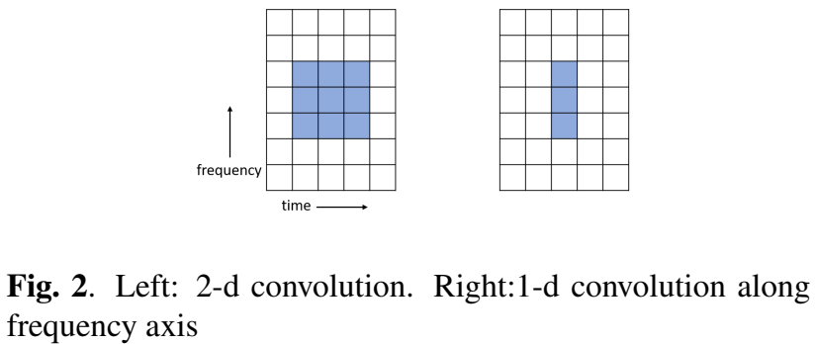
Dilated 2-d and 1-d frequency convolution
Figure 1 shows the frequency-dilated 2-d convolution. By stacking this dilated convolution with an increasing dilation factor, one could keep the size of filter relatively small, while obtaining a large receptive field in frequency
The 1-d convolution is a special case where the filter is only of 1-dimension. In Fig. 2, the 1-d convolution is applied along frequency axis. It is more efficient than 2-d convolution when the goal is to increase the size of receptive field along frequency axis only.

Slide 15
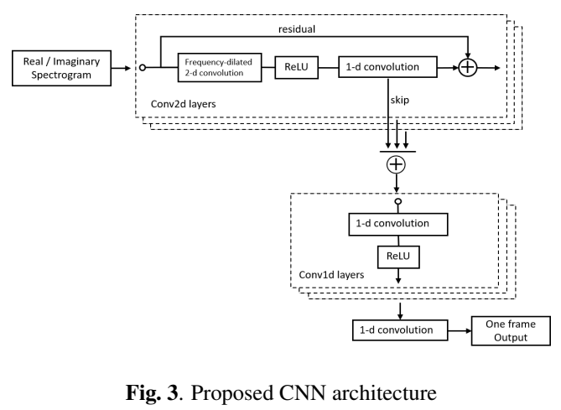
Network Architecture
It consists of fully convolutional and consists of a set of Conv2d and Conv1d layers.
Conv2d layer uses both frequency-dilated 2-d convolution and regular 1-d convolution (fig 1)
Conv1d layer only uses regular 1-d convolution along the frequency axis (fig 2)

Slide 16
SEGAN.

Slide 17
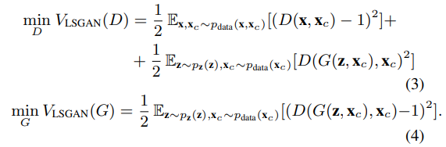
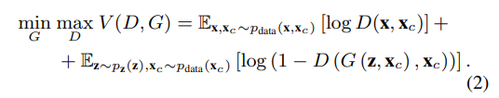
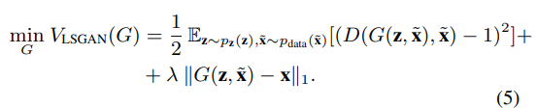
Loss
Loss function is built on Least Squares GAN (LSGAN) (eq. 4) to solve the suffering from vanishing gradients due to the sigmoid cross-entropy loss in normal approach (eq. 2)
We found it convenient to add a secondary component to the loss of G in order to minimize the distance between its generations and the clean example. Add L1 norm

Slide 18
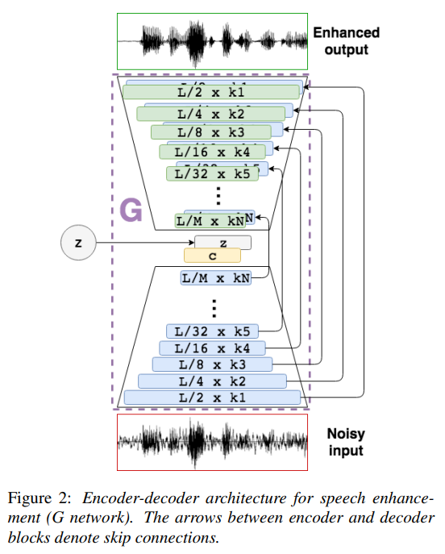
Architecture
G is fully convolutional, which enforces the network to focus on temporally-close correlations in the input signal and throughout the whole layering process
Low level details could be lost if all information flows through bottleneck. Skip connections pass information of the waveform to the decoding stage (e.g., phase, alignment)

Slide 19
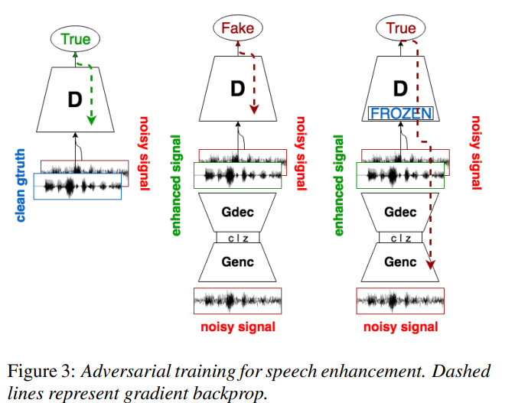
Training

Slide 20
PHASEN: A Phase-and-Harmonics-Aware Speech Enhancement Network.

Slide 21
Contributions
Propose a novel 2-stream DNN architecture with two-way information exchange for efficient speech noise reduction in T-F domain. The proposed architecture is capable of recovering phase information of the target speech.
Design frequency transformation blocks in the amplitude stream to efficiently exploit global frequency correlations, especially the harmonic correlation in spectrogram.

Slide 22
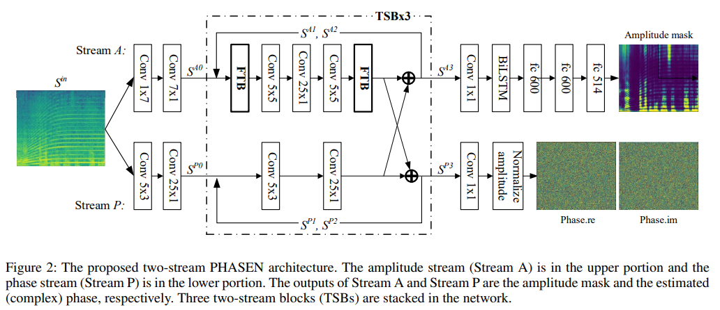
Architecture
Basic idea behind PHASEN is to separate the predictions of amplitude and phase
Input is STFT spectrogram, a complex-valued spectrogram
Key component in PHASEN is the stacked two streams blocks (TSBs) (stream A and P are computed separately). Stream A and P exchange information at the end of each TSB.
Frequency transformation blocks (FTBs) are used to capture non-local correlation along F-axis.

